Slide 1
Introduction to Data Science
TA section 11 – midterm 2 review

Slide 2
Midterm 2 topics: part 1
Supervised Learning: These models are trained with labeled data and are aimed at making predictions or decisions, based on known inputs and outputs.
Bayesian Models
Naive Bayes (including Gaussian Naive Bayes)
Linear Discriminant Analysis (LDA)
Quadratic Discriminant Analysis (QDA)
Non-Bayesian Models
Logistic Regression
Support Vector Machine (SVM)
K-Nearest Neighbors (KNN)
Decision Tree
Random Forest

Slide 3
Midterm 2 topics: part 2
Unsupervised Learning: These models are used to draw inferences from datasets consisting of input data without labeled responses, often used to find patterns or groupings in the data.
Clustering Models
K-Means
Gaussian Mixture Model (GMM)
Manifold Learning
Spectral Embedding

Slide 4
Part 1: Supervised

Slide 5
Bayesian Models
Naive Bayes (including Gaussian Naive Bayes)
Linear Discriminant Analysis (LDA)
Quadratic Discriminant Analysis (QDA)

Slide 6
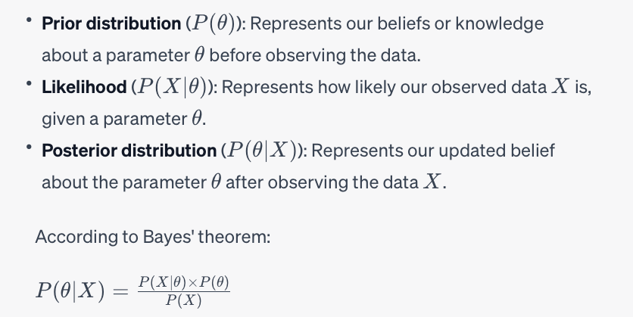
Bayesian Inference Formula

Slide 7
Bayesian Models
NOTE: These three models have different assumptions
Gaussian Naive Bayes:
Data follows Gaussian distribution for each class;
Predictors are I.I.D. (independent and identically distributed).
Linear Discriminant Analysis:
Data follows Gaussian distribution for each class;
Predictors are not necessarily independent, but it is assumed that the covariance matrix is the same for each class.
Quadratic Discriminant Analysis:
Data follows Gaussian distribution for each class;
Predictors are not necessarily independent, and the covariance matrix is not necessarily the same for each class.

Slide 8
Non-Bayesian Models
Logistic Regression
Support Vector Machine (SVM)
K-Nearest Neighbors (KNN)
Decision Tree
Random Forest

Slide 9
Logistic Regression
Used for analyzing a dataset in which there are one or more independent variables that determine an outcome.
Binary Outcome: It is used when the dependent variable is binary in nature (e.g., "yes" vs. "no", "success" vs. "failure").
Logistic function: It predicts the probability of occurrence of an event by fitting data to a logistic function. The logistic function (also known as the sigmoid function) ranges between 0 and 1, thus depicting a probability.

Slide 10
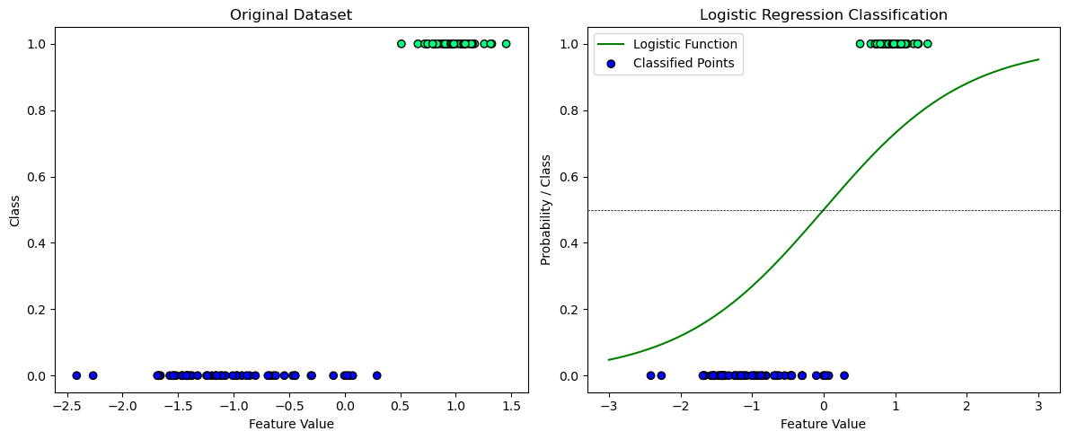
Logistic Regression

Slide 11
Support Vector Machine
Powerful and versatile class of supervised machine learning algorithms, primarily used for classification and regression tasks.
Classification: At its core, an SVM is a classifier that seeks to find the best hyperplane (linear) to separate different classes in a dataset.
In a two-dimensional space, this hyperplane is a line, but in higher dimensions, it can be a plane or a more complex hyper-dimensional surface.
Support Vectors: The algorithm is named after the "support vectors," which are the data points nearest to the hyperplane. These points are critical in defining the hyperplane and hence the decision boundary.
Margin Maximization: The objective of an SVM is to maximize the margin (distance) between the nearest points (of any class) and the hyperplane.

Slide 12
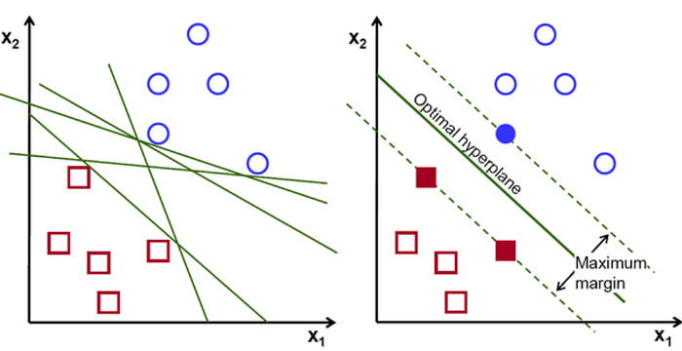
Support Vector Machine

Slide 13
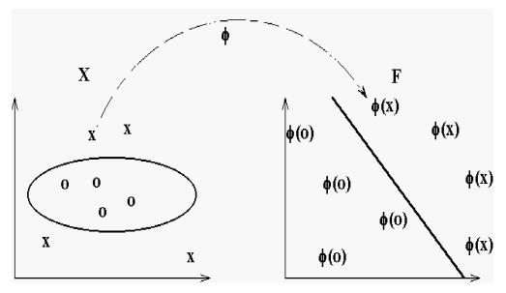
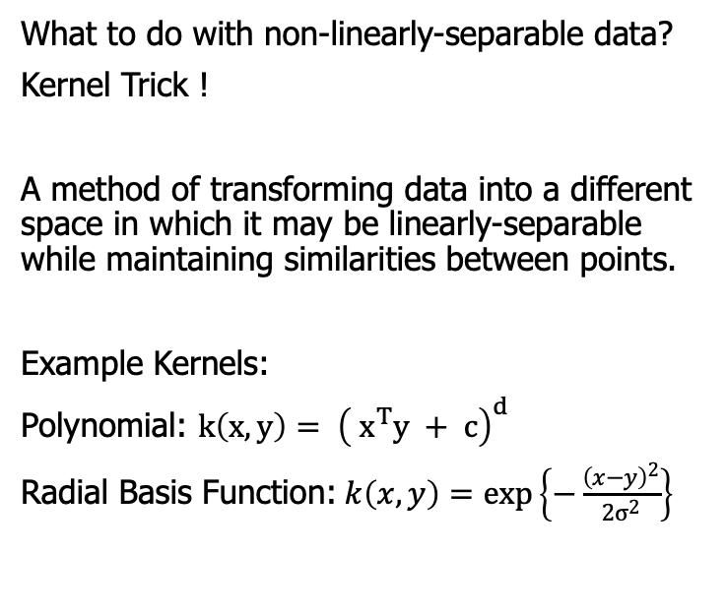
Support Vector Machine
What to do with non-linearly-separable data?
Kernel Trick !
A method of transforming data into a different space in which it may be linearly-separable while maintaining similarities between points.
Example Kernels:
Polynomial: $k\left(x,y\right)= {\left( x^{T}y + c\right)}^{d}$
Radial Basis Function:$k\left(x,y\right)=\exp\left\{−\frac{{\left(x−y\right)}^{2}}{2σ^{2}}\right\}$

Slide 14
K Nearest Neighbors
Goal: KNN works by finding the 'k' closest data points (known as 'neighbors') to the point you want to classify or predict. The algorithm then makes a decision based on the properties of these neighbors.
Classification: In classification tasks, KNN assigns the class most common among its k nearest neighbors.
Distance Measurement: The algorithm typically uses distance metrics like Euclidean, Manhattan, or Hamming distance to determine the nearest neighbors.
Choosing 'k': The value of 'k' (number of neighbors) is crucial. A smaller 'k' can make the model sensitive to noise, while a larger 'k' makes it computationally expensive and potentially less accurate. Finding the right balance is key.

Slide 15
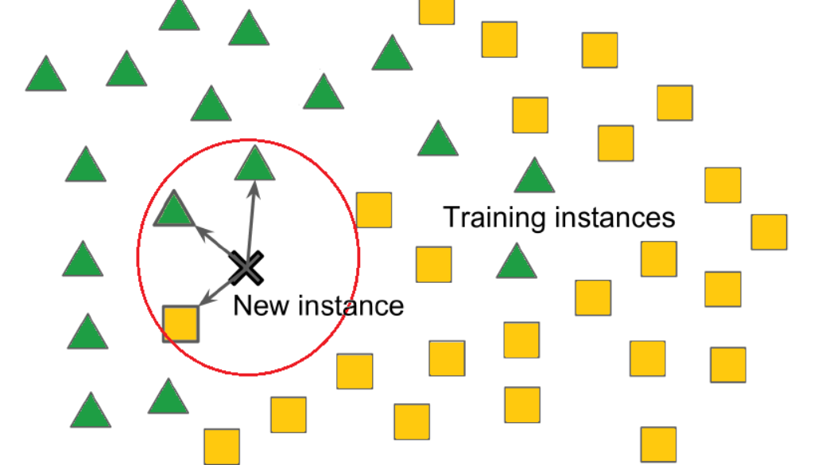
K Nearest Neighbors
https://mlarchive.com/machine-learning/k-nearest-neighbor-knn-explained/

Slide 16
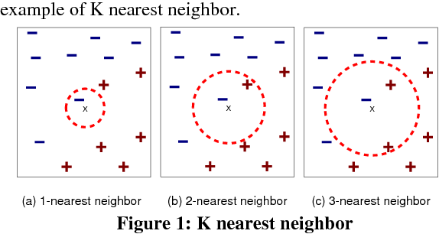
Choosing K
Agrawal, Rashmi. “K-Nearest Neighbor for Uncertain Data.” International Journal of Computer Applications 105 (2014): 13-16.

Slide 17
Decision Tree
Non-parametric supervised learning method used for classification and regression tasks.
Structure: A decision tree is shaped like an inverted tree, with branches and leaf nodes. It starts with a root node and splits into branches based on decision rules, ending at leaf nodes representing a classification or decision.
Decision Making: The decisions to split at each node are made by selecting the feature that best separates the data according to a certain criterion

Slide 18
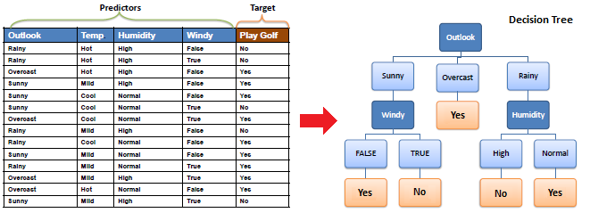
Decision Tree
https://www.saedsayad.com/decision_tree.htm

Slide 19
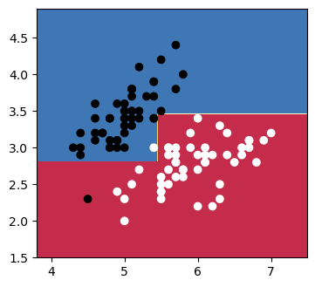
Decision Tree
Example Decision Tree decision boundaries.
Tree that may have made these boundaries:
y < 2.75
no
yes
x > 5.5
white
yes
no
y < 3.5
no
yes
black
black
white

Slide 20
Random Forest
An ensemble learning method that operates by constructing multiple decision trees during training and outputting the class that is the mode/majority of the classes
Ensemble Method: Random Forest combines the predictions from multiple machine learning algorithms together to make more accurate and robust predictions than any individual model.
Decision Trees: It builds many decision trees on various sub-samples of the dataset and uses averaging to improve the predictive accuracy and control over-fitting.

Slide 21
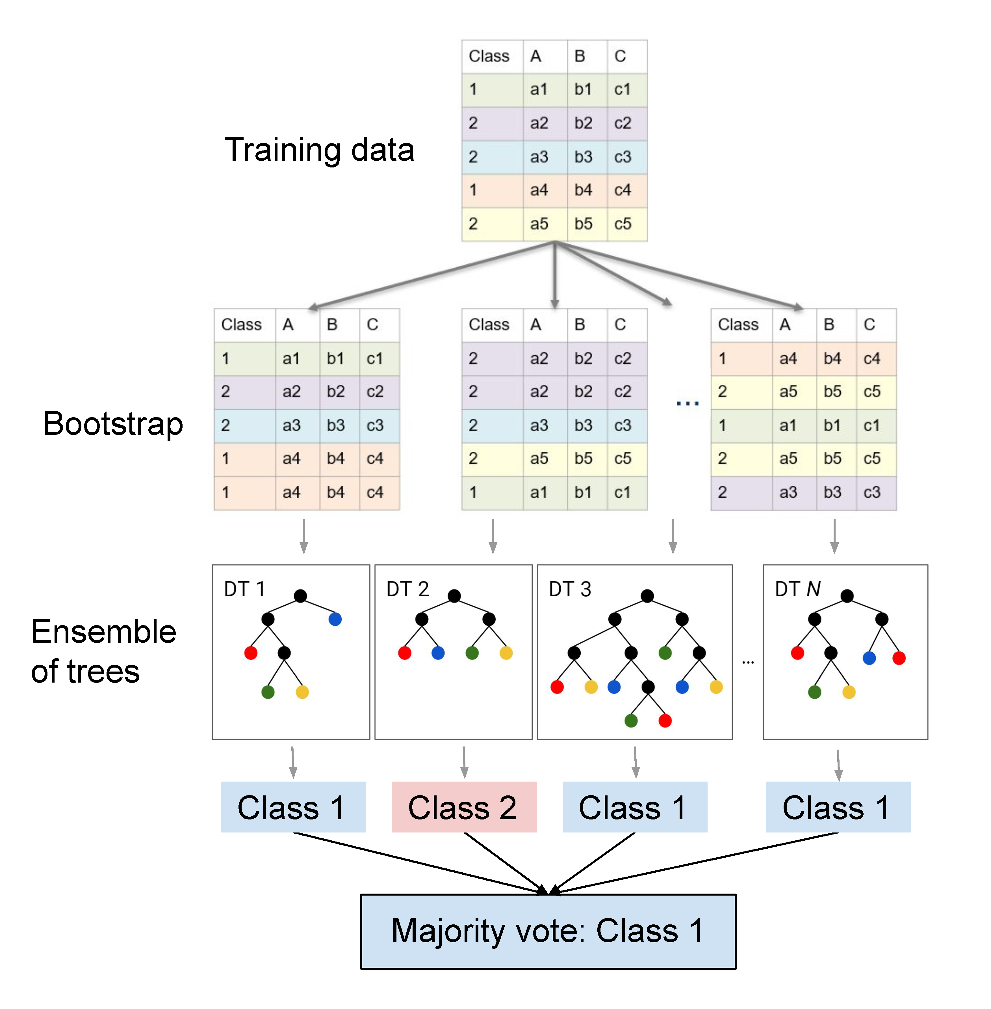
https://pages.cms.hu-berlin.de/EOL/geo_rs/S09_Image_classification2.html

Slide 22

Cross Validation

Slide 23
Part 2: Unsupervised

Slide 24
K-means
Goal: Partition the data into K distinct, non-overlapping subgroups (clusters).
Algorithm:
Initialization. Choose K initial centroids randomly from the data points.
Assignment. Assign each data point to the closest centroid, thus forming K clusters.
Update. Recalculate the centroids as the mean of all points in the cluster.
Repeat the assignment and update steps until the centroids do not change significantly, or a maximum number of iterations is reached.
Typically, we rerun the algorithm using many different initializations and pick the best result from them. (qn: best in terms of?)

Slide 25
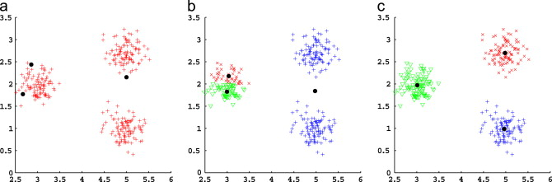
K-means
https://doi.org/10.1016/j.patcog.2014.01.015

Slide 26
Gaussian Mixture Models
Type of probabilistic model used for representing normally distributed subpopulations within an overall population.
Goal: The goal of GMMs is to model complex data distributions by representing them as a combination of several Gaussian distributions, each characterized by a mean (μ), covariance matrix (Σ^2), and a weight (which indicates the proportion of the population represented by each Gaussian component).
Parameter Estimation: The parameters (means, covariance matrix, and weights) of the GMM are typically estimated using the Expectation-Maximization (EM) algorithm.

Slide 27
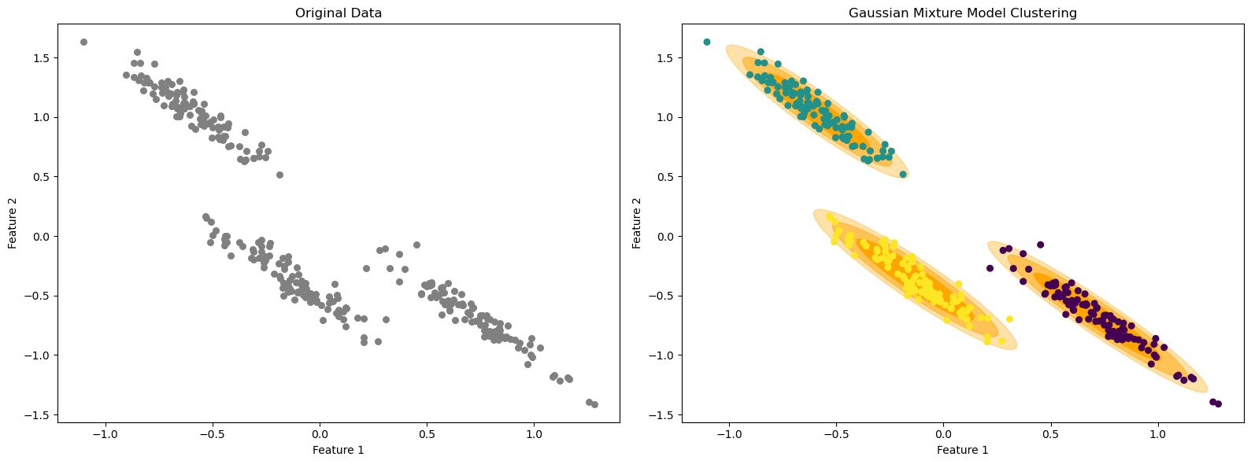
Gaussian Mixture Models

Slide 28
Spectral
Steps:
Build adjacency matrix based on distance threshold
Calculate D the degree matrix
Calculate L the graph Laplacian
Solve the eigenproblem of L
Study the eigenvectors and values

Slide 29
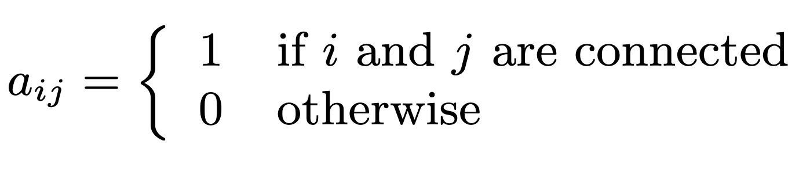
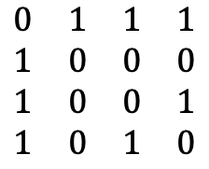
Spectral
1
2
$$\begin{matrix}0 & 1 & 1 & 1 \\ 1 & 0 & 0 & 0 \\ 1 & 0 & 0 & 1 \\ 1 & 0 & 1 & 0\end{matrix}$$
3
4
Adjacency Matrix (A)
Are two nodes connected? Encode it in an n x n matrix.

Slide 30
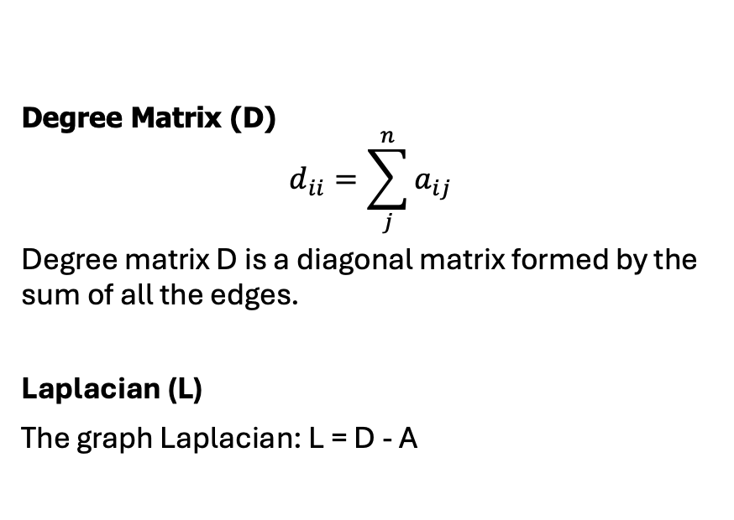
Spectral
1
2
$$\begin{matrix}0 & 1 & 1 & 1 \\ 1 & 0 & 0 & 0 \\ 1 & 0 & 0 & 1 \\ 1 & 0 & 1 & 0\end{matrix}$$
3
4
Degree Matrix (D)
$$d_{ii}=\sum_{j}^{n}{a_{ij}}$$
Degree matrix D is a diagonal matrix formed by the sum of all the edges.
Laplacian (L)
The graph Laplacian: L = D - A

Slide 31
Spectral
1
2
$$\begin{matrix}0 & 1 & 1 & 1 \\ 1 & 0 & 0 & 0 \\ 1 & 0 & 0 & 1 \\ 1 & 0 & 1 & 0\end{matrix}$$
3
4
Minimization:
Solution: the smallest eigenvalues of $L$ and corresponding eigenvectors
The 1st eigenvector is the trivial solution
A vector of ones corresponding to the eigenvalue of 0
We use the 2nd eigenvector, and so on...

Slide 32
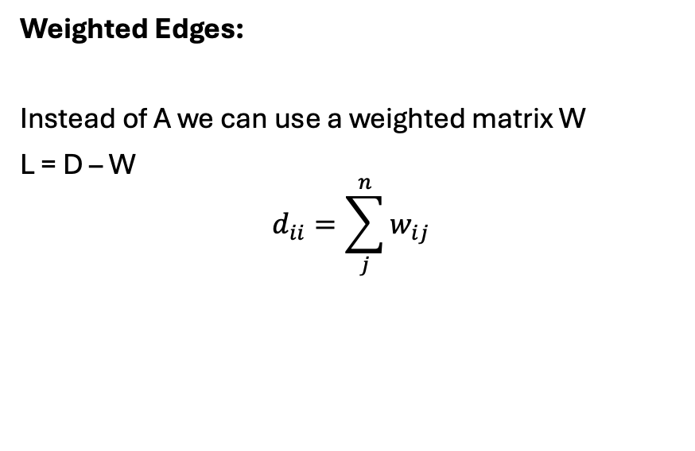
Spectral
1
2
$$\begin{matrix}0 & 1 & 1 & 1 \\ 1 & 0 & 0 & 0 \\ 1 & 0 & 0 & 1 \\ 1 & 0 & 1 & 0\end{matrix}$$
3
4
Weighted Edges:
Instead of A we can use a weighted matrix W
L = D – W
$$d_{ii}=\sum_{j}^{n}{w_{ij}}$$

Slide 33
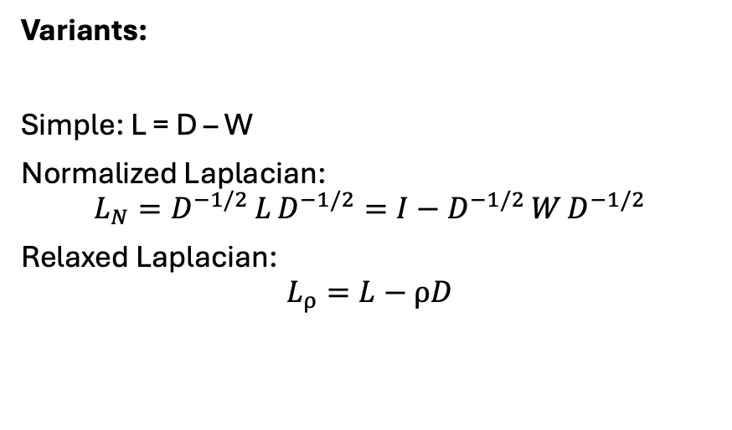
Spectral
1
2
$$\begin{matrix}0 & 1 & 1 & 1 \\ 1 & 0 & 0 & 0 \\ 1 & 0 & 0 & 1 \\ 1 & 0 & 1 & 0\end{matrix}$$
3
4
Variants:
Simple: L = D – W
Normalized Laplacian:
$$L_{N}=D^{−1/2} L D^{−1/2}=I−D^{−1/2} W D^{−1/2}$$
Relaxed Laplacian:
$$L_{ρ}=L−ρD$$

